Slide 1
MLA 8th Edition
Reminders, Updates, and Helpful Tools

Slide 2
Purpose and Tasks - AP Research course
Purpose of the lesson:
Review general citation guidelines that every responsible researcher needs to know
Learn about the changes in MLA 8th edition
Learn about helpful resources available on the Media Center website
Tasks:
Review: general citation guidelines
Mini-lesson: MLA 8
Assessment: Make MLA 8 corrections
Assessment due WEDNESDAY

Slide 3
Goal: Make your documentation useful to the reader
Good writers understand why they create citations.
-Demonstrating thoroughness of research
-Giving credit to original sources
-Ensuring readers can find the sources consulted
To achieve this goal, the documentation should provide sufficient information in a consistent structure.
Notes:
Understanding why you cite sources may help you realize just how important using quality sources is.

Slide 4
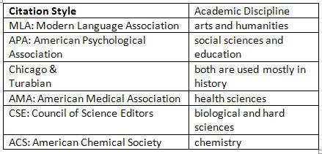
Common Citation Formats

Slide 5
Using EasyBib/Noodletools/Databases to cite sources:
EasyBib and the database citations are TOOLS for helping you create and organize your works cited lists.
It is YOUR job (with help!) to verify that everything you need is there & accurate!

Slide 6
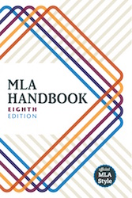
MLA = Modern Language Association
MLA is one of several accepted styles for writing papers and creating works cited lists. MLA is the standard style for high school research.
The new handbook “really focuses on principles -- not just on how to create a citation that is correct, but on the purposes of citation practice, as well as on strategies for evaluating sources”(Flaherty).
Notes:
I know you’ve already learned the MLA paper formatting rules. This lesson show you how to begin creating an MLA jWorks Cited list for the sources you use when writing papers.

Slide 7
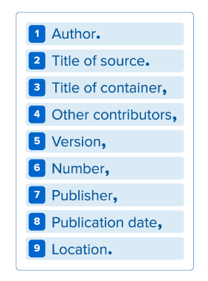
What’s in your citations-
When deciding how to cite your source, start by consulting the list of core elements. In your citation, the elements should be listed in the following order:
Each element should be followed by the punctuation mark shown here (just commas and periods separate the elements).
Notes:
Important elements in a work cited list.

Slide 8
Author:
Begin the entry with the author’s last name, followed by a comma and the rest of the name, as presented in the work. End this element with a period.
Said, Edward W. Culture and Imperialism. Knopf, 1994.

Slide 9
Title of Source:
The title of the source should follow the author’s name. Depending upon the type of source, it should be listed in italics or quotation marks.
A book should be in italics:
Henley, Patricia. The Hummingbird House. MacMurray, 1999.
A website should be in italics:
Lundman, Susan. "How to Make Vegetarian Chili."eHow, www.ehow.com/how_10727_make-vegetarian-chili.html.

Slide 10
Title of Source:
A periodical (journal, magazine, newspaper article) should be in quotation marks:
Bagchi, Alaknanda. "Conflicting Nationalisms: The Voice of the Subaltern in Mahasweta Devi's Bashai Tudu." Tulsa Studies in Women's Literature, vol. 15, no. 1, 1996, pp. 41-50.

Slide 11
NEW CONCEPT: Containers
Containers are the larger entity in which the source is located. The title of the container is usually italicized and followed by a comma, since the information that follows next describes the container.
EXAMPLES
A poetry collection (individual poem)
A TV series (individual episodes)
A website (articles, postings, other works)

Slide 12
New Concept: Containers Within Containers
In some cases, a container might be within a larger container. It is important to cite these containers within containers so that your readers can find the exact source that you used.
EXAMPLES
Read a book of short stories on Google Books
Watched a television series on Netflix
Electronic version of a journal on the Gale databases

Slide 13
Partner Activity: Find the containers & Determine Order of the Entries
Kincaid, Jamaica. "Girl." The Vintage Book of Contemporary American Short Stories, edited by Tobias
Wolff, Vintage, 1994, pp. 306-07.
“94 Meetings.” Parks and Recreation, created by Greg Daniels and Michael Schur, performance by Amy
Poehler, season 2, episode 21, Deedle-Dee Productions and Universal Media Studios, 2010.
Zinkievich, Craig. Interview by Gareth Von Kallenbach. Skewed & Reviewed, 27 Apr. 2009, www.arcgames.com/en/games/star-trek-online/news/detail/1056940-skewed-%2526-reviewed-
interviews-craig. Accessed 15 Mar. 2009.
“94 Meetings.” Parks and Recreation, season 2, episode 21, NBC, 29 Apr. 2010. Netflix,
www.netflix.com/watch/70152031?trackId=200256157&tctx=0%2C20%2C0974d361-27cd-44de- 9c2a-2d9d868b9f64-12120962.
Langhamer, Claire. “Love and Courtship in Mid-Twentieth-Century England.” Historical Journal, vol. 50, no. 1, 2007, pp. 173-96.ProQuest, doi:10.1017/S0018246X06005966. Accessed 27 May 2009.

Slide 14
Book Sources: MLA 8

Slide 15
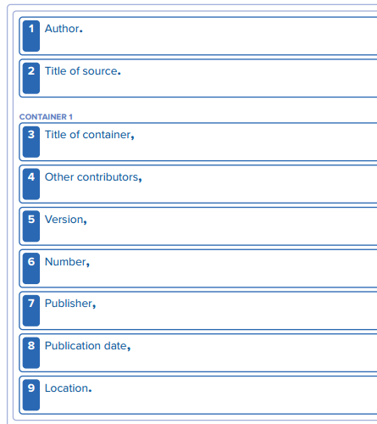
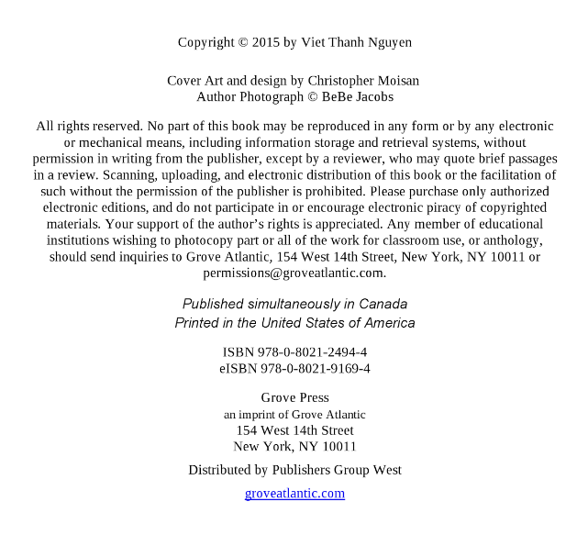
Pub date #8
Nguyen, Viet Thanh.
The Sympathizer.
Title #2
#1 Author
Grove Press,
2015.
#7 Publisher
Notes:
What do you notice about the author’s name in the form? Why do you think so few of the elements are filled in?

Slide 16
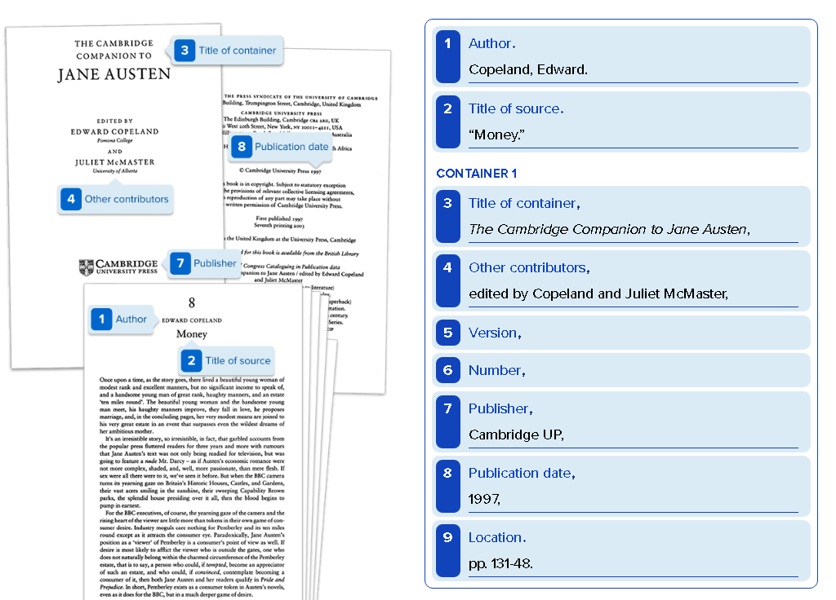
Notes:
What do you notice about the Author’s name? What about the Two titles?

Slide 17
Database Sources: MLA 8

Slide 18
Database Articles: MLA 7 vs. 8
Example
The differences in citing an article from a scholarly journal:
7th edition:
Kinkaid, Jamaica. “In History.” Callaloo 24.2 (Spring 2001): 620-26. Web.
--------------------------------------------------------------------------------------------------------------------8th edition:
Kincaid, Jamaica. “In History.” Callaloo, vol. 24, no. 2, Spring 2001, pp. 620-26,
https://www.researchgate.net/publication/236763809_In_History. Accessed 1
June 2015.

Slide 19
Sample Works Cited Page

Slide 20
